Slide 1


UNIT 5: Me and the World
Unit 5 – Roundup & Writing rules 5

Slide 2
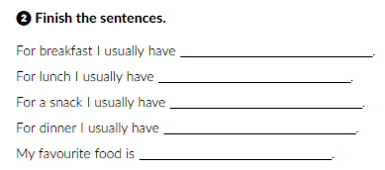
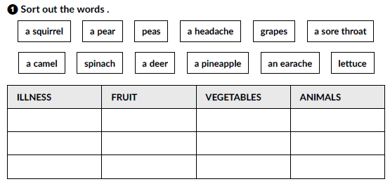

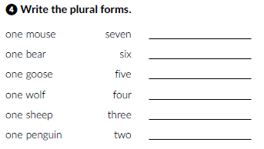
Workbook, p. 71-72.
a
an
an
peas
an
a
a
a headache
a pear
a squirrel
a sore throat
grapes
spinach
a camel
an earache
a pineapple
lettuce
a deer
mice
bears
geese
wolves
sheep
penguins

Slide 3
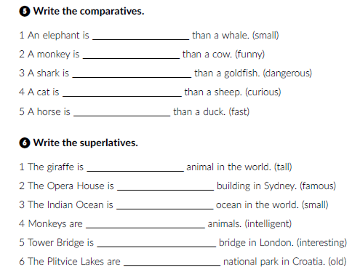
smaller
funnier
more dangerous
more curious
faster
the tallest
the most famous
the smallest
the most intelligent
the most interesting
the oldest

Slide 4
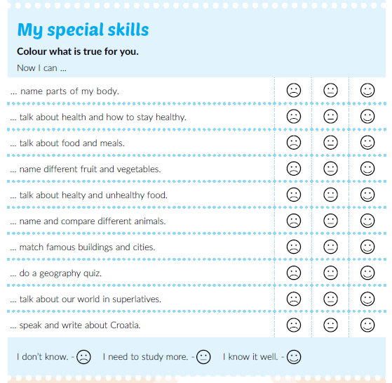
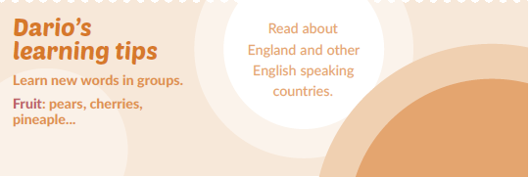
Textbook, p. 101
Read Dario’s learning tips.

Slide 5
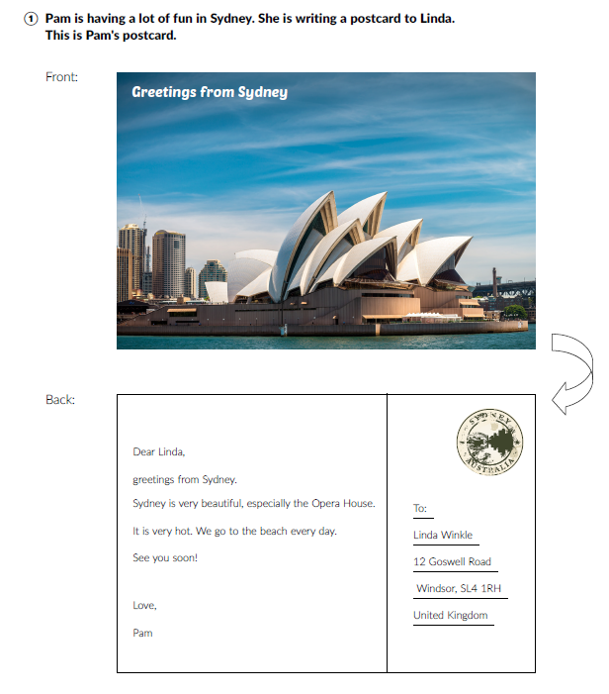
Where would you like to travel and why?
Have you got any relatives abroad?
Do you post pictures from your travels online?
Do you send postcards to your friends?
Do you know your friend’s adresses?
Read the text at page 99 in your book.
Where is Pam?
Who is she sending a postcard to?
What is Linda’s address?
What does Pam find to be very beautiful in Sydney?
What is the weather like?

Slide 6
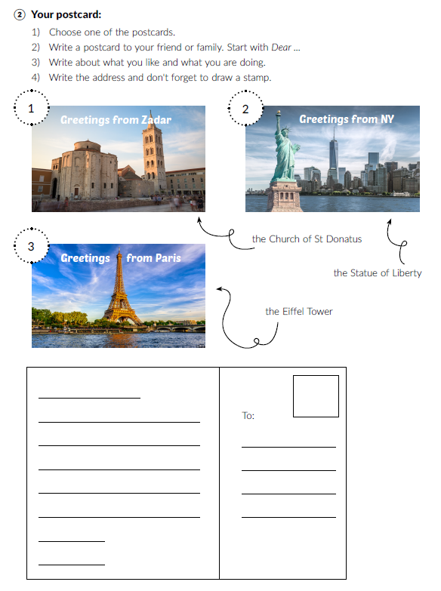
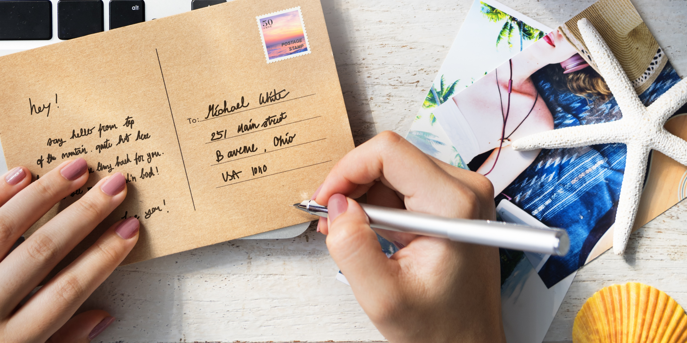
Read the instructions and write a postcard to your friend or family.

